Slide 1
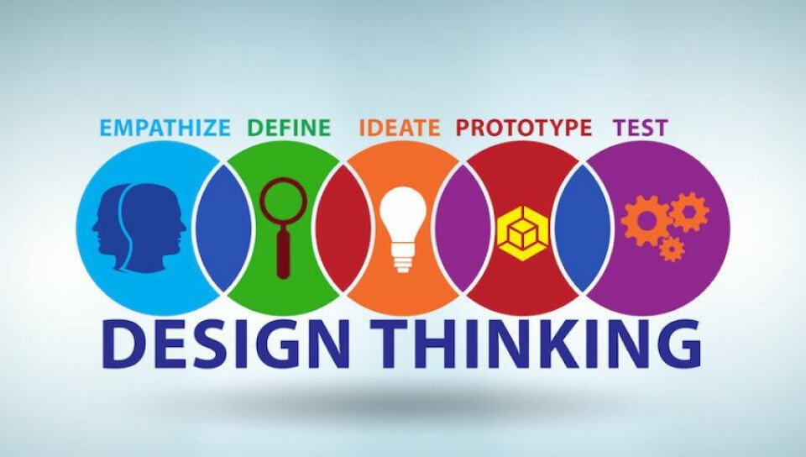
U20ITT615 – Design Thinking III Year / VI Semester

Slide 2
Course Outcomes
CO1 - Explain the fundamentals of Design Thinking and innovation. (K2)
CO2 - Empathize and analyze model action plan. (K2)
CO3 - Describe the principles of innovation and idea generation for product design. (K2)
CO4 - Apply design thinking techniques for given tasks. (K3)
CO5 - Apply the design thinking techniques for solving problems in various sectors. (K3)

Slide 3
Syllabus
UNIT I INTRODUCTION TO DESIGN
Introduction to elements and principles of Design, basics of design-dot, line, shape, form as fundamental design components. Principles of design - Introduction to design thinking - history of Design Thinking - New materials in Industry.
UNIT II- DESIGN THINKING
Design thinking process (empathize, analyze, idea & prototype), implementing the process in driving inventions, design thinking in social innovations. Tools of design thinking - person, costumer, journey map, brain storming, product development.
UNIT III- INNOVATION AND PRODUCT DESIGN
Art of innovation, Difference between innovation and creativity, role of creativity and innovation in organizations. Creativity to Innovation. Teams for innovation, Measuring the impact and value of creativity. Problem formation, introduction to product design, Product strategies, Product value, Product planning, product specifications
UNIT IV – DESIGN THINKING FOR STRATEGIC INNOVATION
An exercise in design thinking – implementing design thinking for better process. Implement design thinking process in various Industries. Design thinking for Startups.
UNIT V – DESIGN THINKING IN VARIOUS SECTORS
Case studies in Information Technology, Finance, Education, Management and Retail sector. Analyze and Prototyping, Usability testing, Organizing and interpreting results

Slide 4
Text Books and References
Text Books:
Change by design, Tim Brown, Harper Bollins(2009)
Design thinking in the Class Room by David Lee, Ulyssespress.
Product Design and Manufacturing by A.K. Chitale and R.C. Gupta, PrenticeHall
Reference Books:
Design the Future , by Shrrutin N Shetty , NortonPress
Universal principles of design- William lidwell, kritina holden, Jillbutter.
The era of open innovation –chesbrough.H
Websites:
https://drive.google.com/file/d/1cplqb1eOWnoNMhFWNP8TyYLF2qHdGY_K/view
https://nptel.ac.in/courses/110/106/110106124/#

Slide 5
UNIT I
UNIT I - INTRODUCTION TO DESIGN
Introduction to elements and principles of Design
basics of design-dot, line, shape, form as fundamental design components.
Principles of design
Introduction to design thinking
history of Design Thinking
New materials in Industry.

Slide 6
Design Thinking
It is a process of thinking, collecting and working various hands on methods for solving problems
Design thinking is a process for creative problem solving.
Design Thinking provides a solution-based approach to solving problems.
Design Thinking revolves around a deep interest in developing an understanding of the people for whom we’re designing the products or services.
Design Thinking is an iterative process in which we seek to understand the user, challenge assumptions, and redefine problems in an attempt to identify alternative strategies and solutions that might not be instantly apparent with our initial level of understanding.

Slide 7
Design Thinking
For Example,
When you sit down to create a product for a business need
The first question should always be what's the human need behind it?
for whom we’re designing the products or services. ?
what’s desirable from a human point of view with what is technologically feasible and economically viable

Slide 8
Design Thinking Uses
Design Thinking revolves around a deep interest in developing an understanding of the people for whom we’re designing the products or services.
It helps us observe and develop empathy (understand client need) with the target user.
Design Thinking helps us in the process of questioning: questioning the problem, questioning the assumptions, and questioning the implications.
Design Thinking is extremely useful in tackling problems that are ill-defined or unknown, by re-framing the problem in human-centric ways, creating many ideas in brainstorming sessions, and adopting a hands-on approach in prototyping and testing.
Design Thinking also involves ongoing experimentation: sketching, prototyping, testing, and trying out concepts and ideas.

Slide 9
Design Thinking Applications:
Design thinking is applicable no matter your role or industry. Whether you work in business, government, education, or nonprofit, design thinking can help you develop innovative solutions based on the needs of your customers.

Slide 10
Design thinking can help your team or organization:
Better understand the unmet needs of the people you’re creating for (customers, clients, students, users, etc...).
Reduce the risk associated with launching new ideas, products, and services.
Generate solutions that are revolutionary, not just incremental.
Learn and iterate faster.

Slide 11
Design Thinking
Four Pillars or Phases

Slide 12

Empathy
Design Thinking
Notes:
Understanding the issue from the users perspective.

Slide 13

Collaboration
Design Thinking
Notes:
Appreciating a diversity if perspectives and skillsets. Can’t Design Think alone.

Slide 14

Inclusion
Design Thinking
Notes:
Every idea counts!

Slide 15
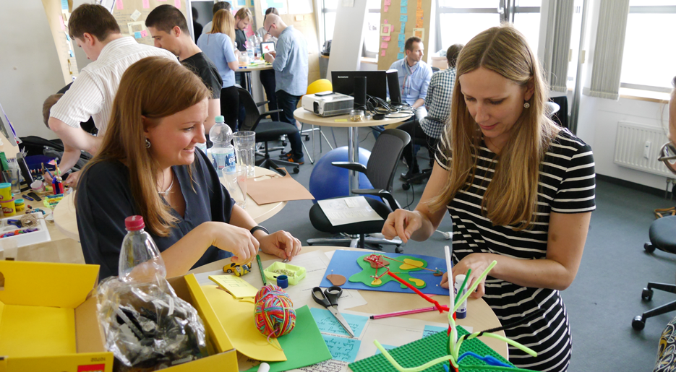
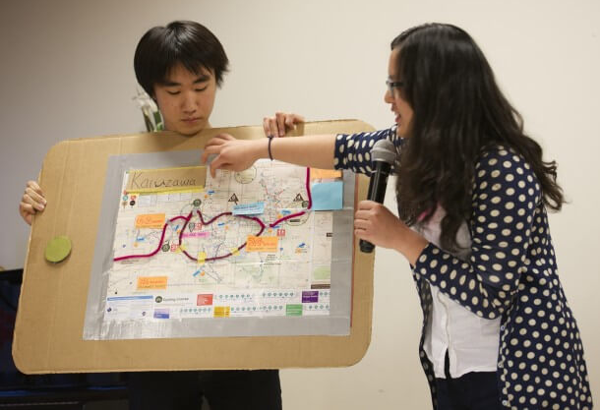
Repeat/Iterate
Design Thinking
Notes:
Getting ideas out into the open for evaluation. Getting user feedback.

Slide 16
Design Thinking
Empathize with people's needs,
Collaborate with others across disciplines, skill sets, and perspectives,
Include every idea in visible form for evaluation, and
Repeat, iterating and testing solutions to perfect them, always with human needs at the center.

Slide 17
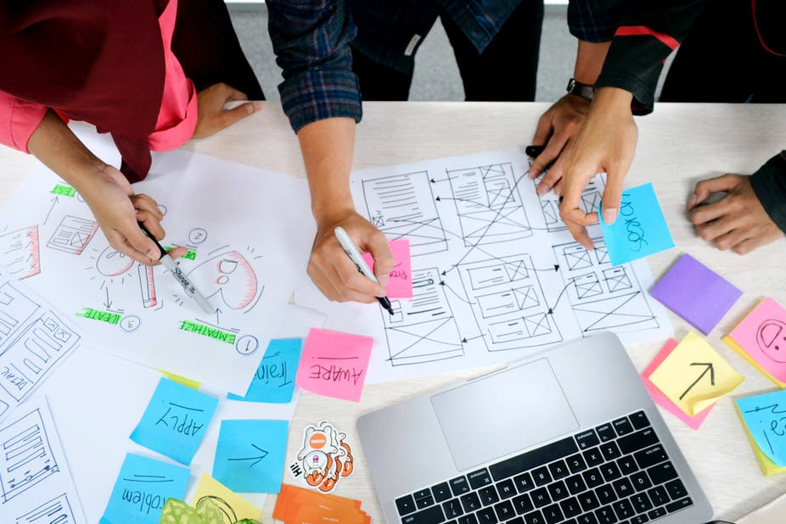
Introduction to Design
A design is a plan or specification for the construction of an system or for the implementation of an activity or process
The way in which something is planned and made or arranged
EXAMPLE:
To design a car, dress, house, software, video games etc

Slide 18
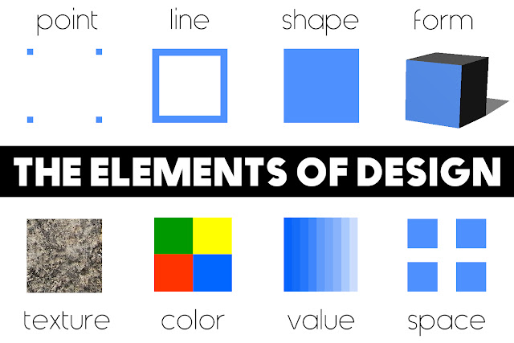
Elements of Design

Slide 19
Elements of Design
The elements of design, are the building blocks used by the designers to create the designs
The elements of design are the fundamental aspects of any visual design which include shape, color, space, form, line, value, and texture

Slide 20
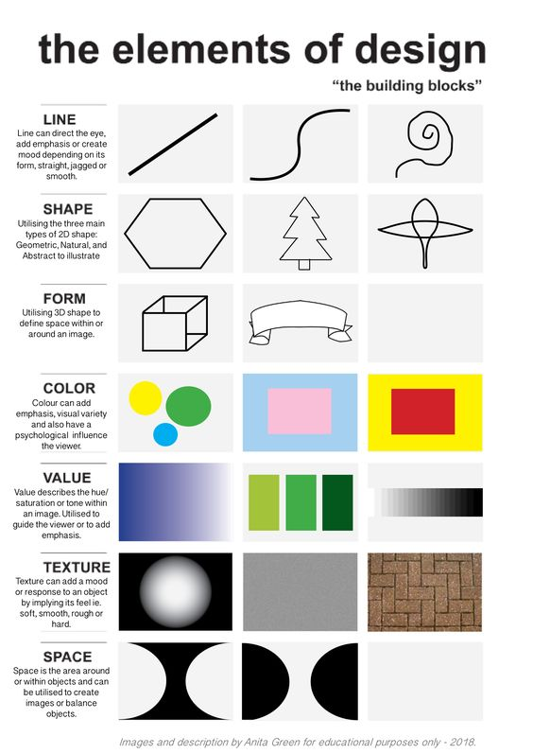

Slide 21
Elements of Design
Color: Color helps establish a mood for your composition. Artists and designers use color to depict and describe the subject. Color is used by designers to portray mood, light, depth, and point of view.
Line: Line refers to the way that two points in space are connected. Whether they’re horizontal lines, diagonal lines, or vertical lines, lines can help direct the eye toward a certain point in your composition
Value refers to the lightness or darkness of a color. The values of a color are often visualized in a gradient, which displays a series of variations on one hue, arranged from the lightest to the darkest

Slide 22
Elements of Design
Space: Making proper use of space can help others view your design as you intended. White space or negative space is the space between or around the focal point of an image. The spacing of your design is important because a layout that’s too crowded can overwhelm the viewer’s eye.
Shape: In its most basic form, a shape is a two-dimensional area that is surrounded by an outline. There are three types of shapes organic shapes, geometric shapes and abstract shapes
Form: Utilizing 3D shape to define the space within or around the image designers create the appearance of form on a flat surface by using light, shadow, the appearance of an object’s contours, negative space, and the surrounding objects around the subject matter.
Texture: Texture is one of the elements of design that is used to represent how an object appears or feels. Tactile texture is a physical sense of touch, whether it’s rough, smooth, or ribbed. Visual texture, on the other hand, refers to the imagined feel of the illustrated texture, which can create more visual interest and a heightened sensory experience.

Slide 23
Principles of design
The principles of design are the rules a designer must follow to create an effective and attractive composition
The fundamental principles of design are
Unity
Emphasis
Balance and Alignment
Hierarchy
Contrast
Scale
Repetition

Slide 24
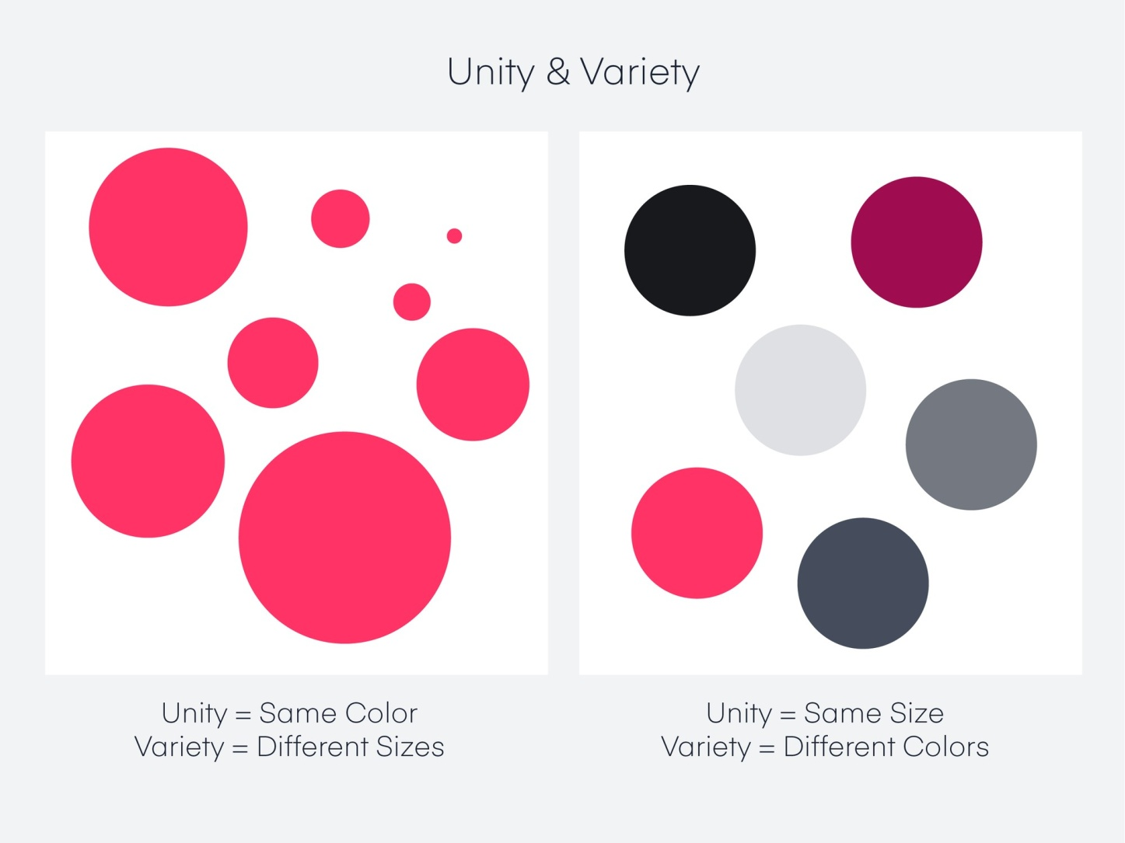
Principles of Design
Unity
Unity is a force operating within a design that gives it the appearance of oneness or resolution. This ensures no single part is more important than the other

Slide 25
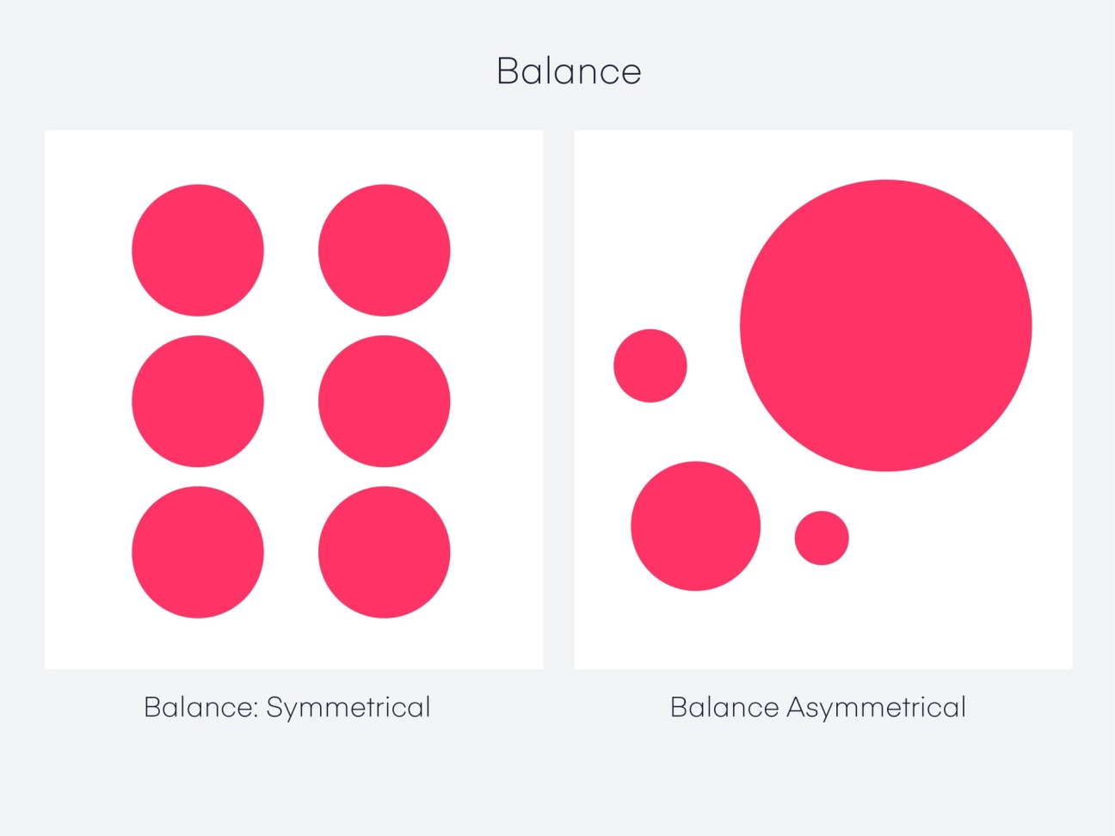
Principles of Design
Balance
Objects in design carry weight just like in the physical world, but it’s called visual weight. The visual weight of a design needs to have balance. It’s like putting two objects on a seesaw: If one side is too heavy, the viewer’s eye goes directly to the heavy part. If it’s weighted with all things equal, the seesaw is perfectly suspended without either side touching the ground.

Slide 26
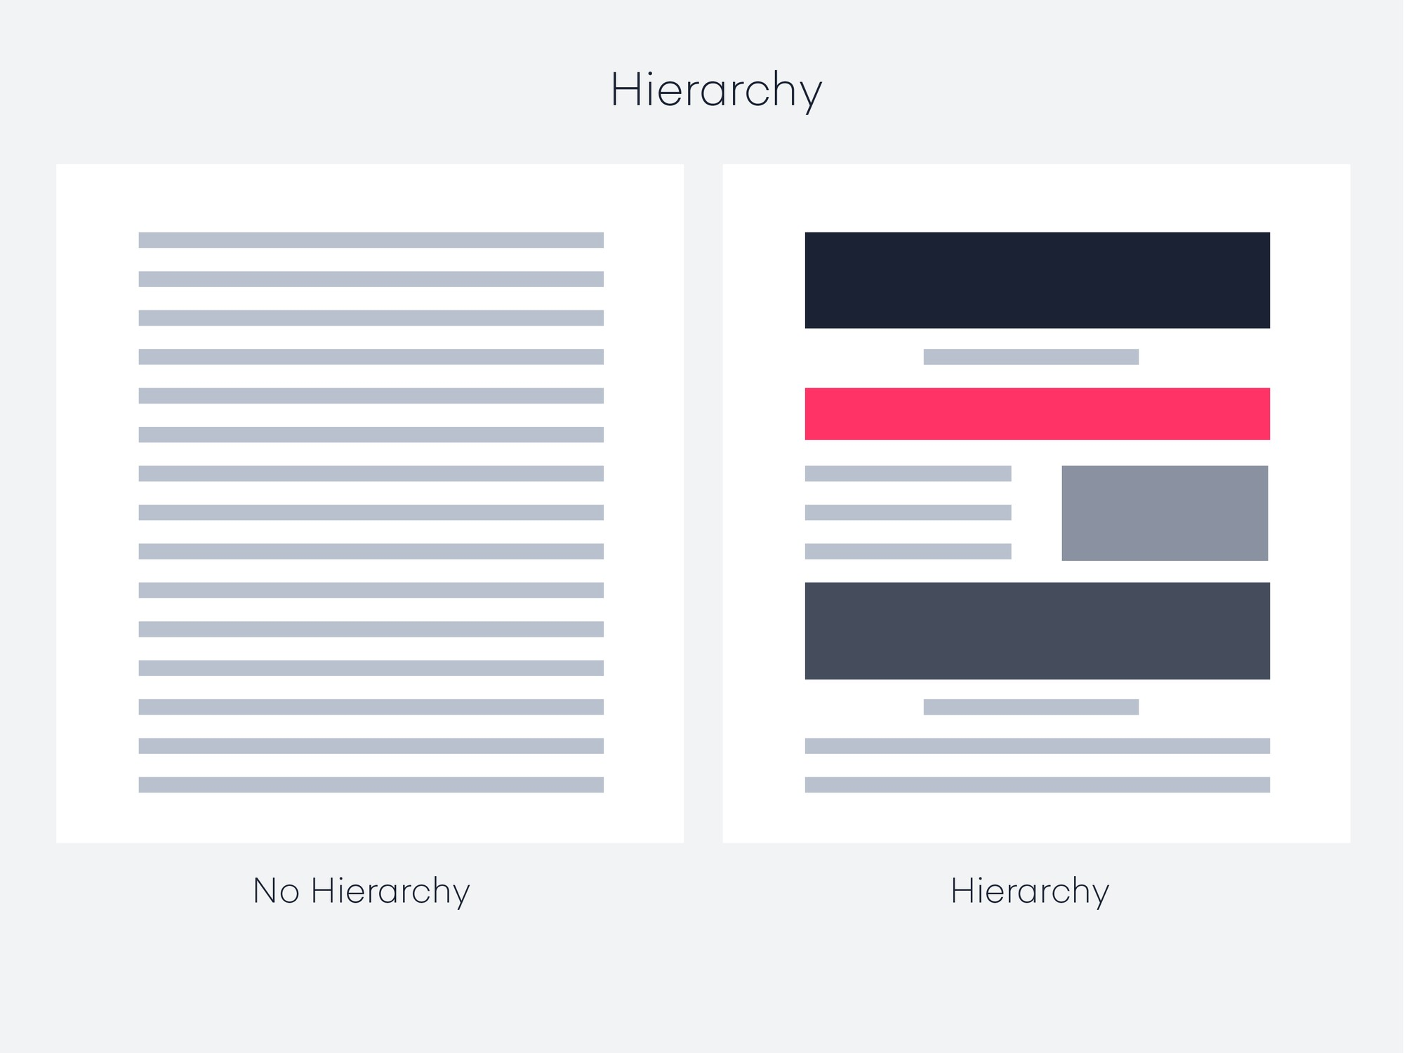
Principles of Design
Hierarchy
One of the most important principles in design, hierarchy is a way to visually rank your design elements
.
Hierarchy is not based on a design styles, but rather the order of importance. A good design leads the eye through each area in priority order. A good example is a homepage: There’s usually a navigation bar and a logo, some sort of large header image, or text with a call to action

Slide 27
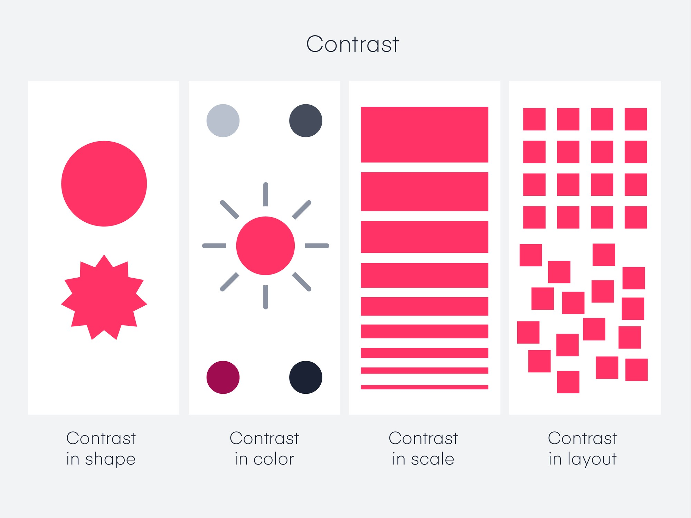
Principles of Design
Contrast
The difference between two or more objects in a design is referred to as contrast. The difference in objects could be light and dark, thin and thick, small and large, bright and dull, etc.

Slide 28
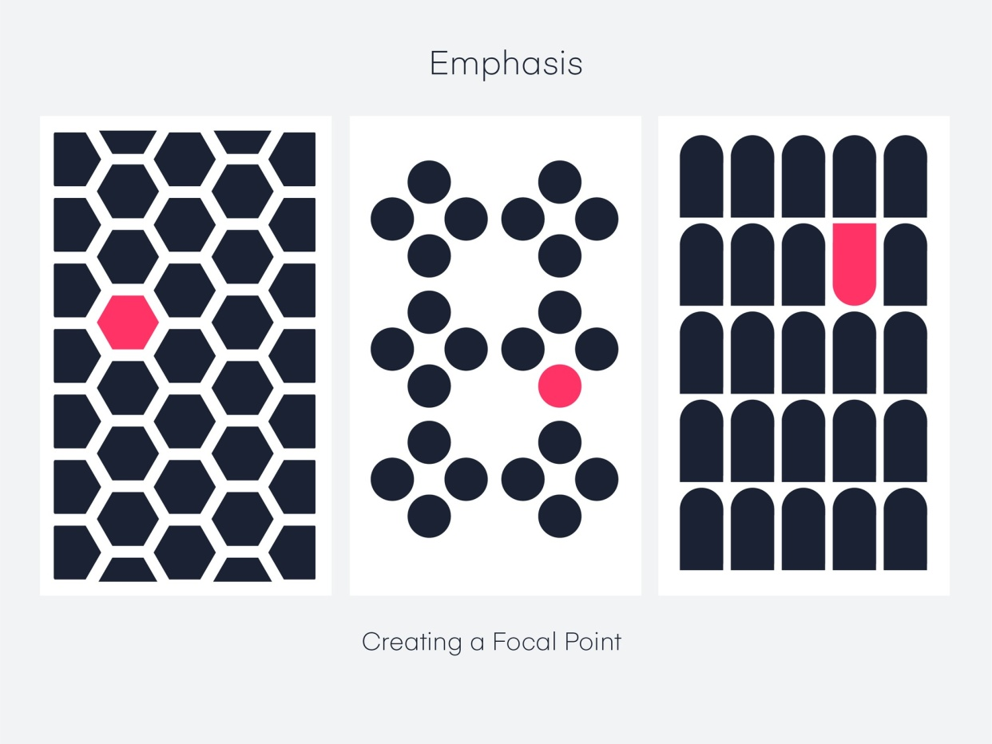
Principles of Design
Emphasis
Emphasis can be created by size, weight, position, color, shape, and style. Sometimes referred to as dominance, emphasis might seem similar to contrast, but it’s not quite the same. Contrast deals with the difference between two objects, and emphasis deals with the impact of an object.

Slide 29
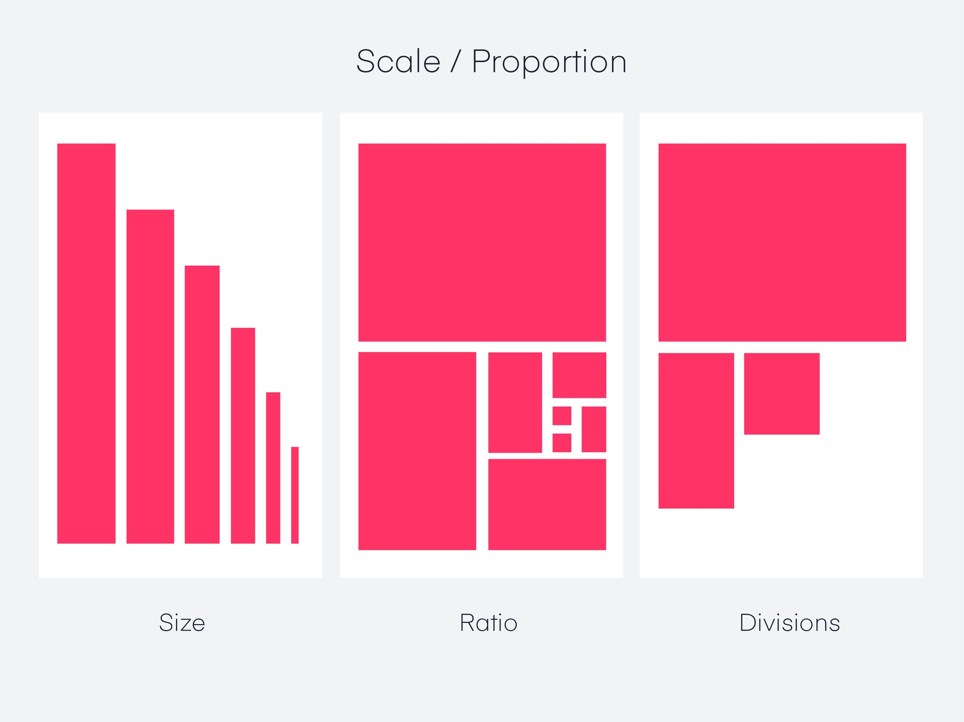
Principles of Design
Scale
Scale is the sizing of elements or a standard of measurement. It can be used in combination with other principles like emphasis to draw the viewer into a focal point, and helps us make sense of designs or imagery.

Slide 30
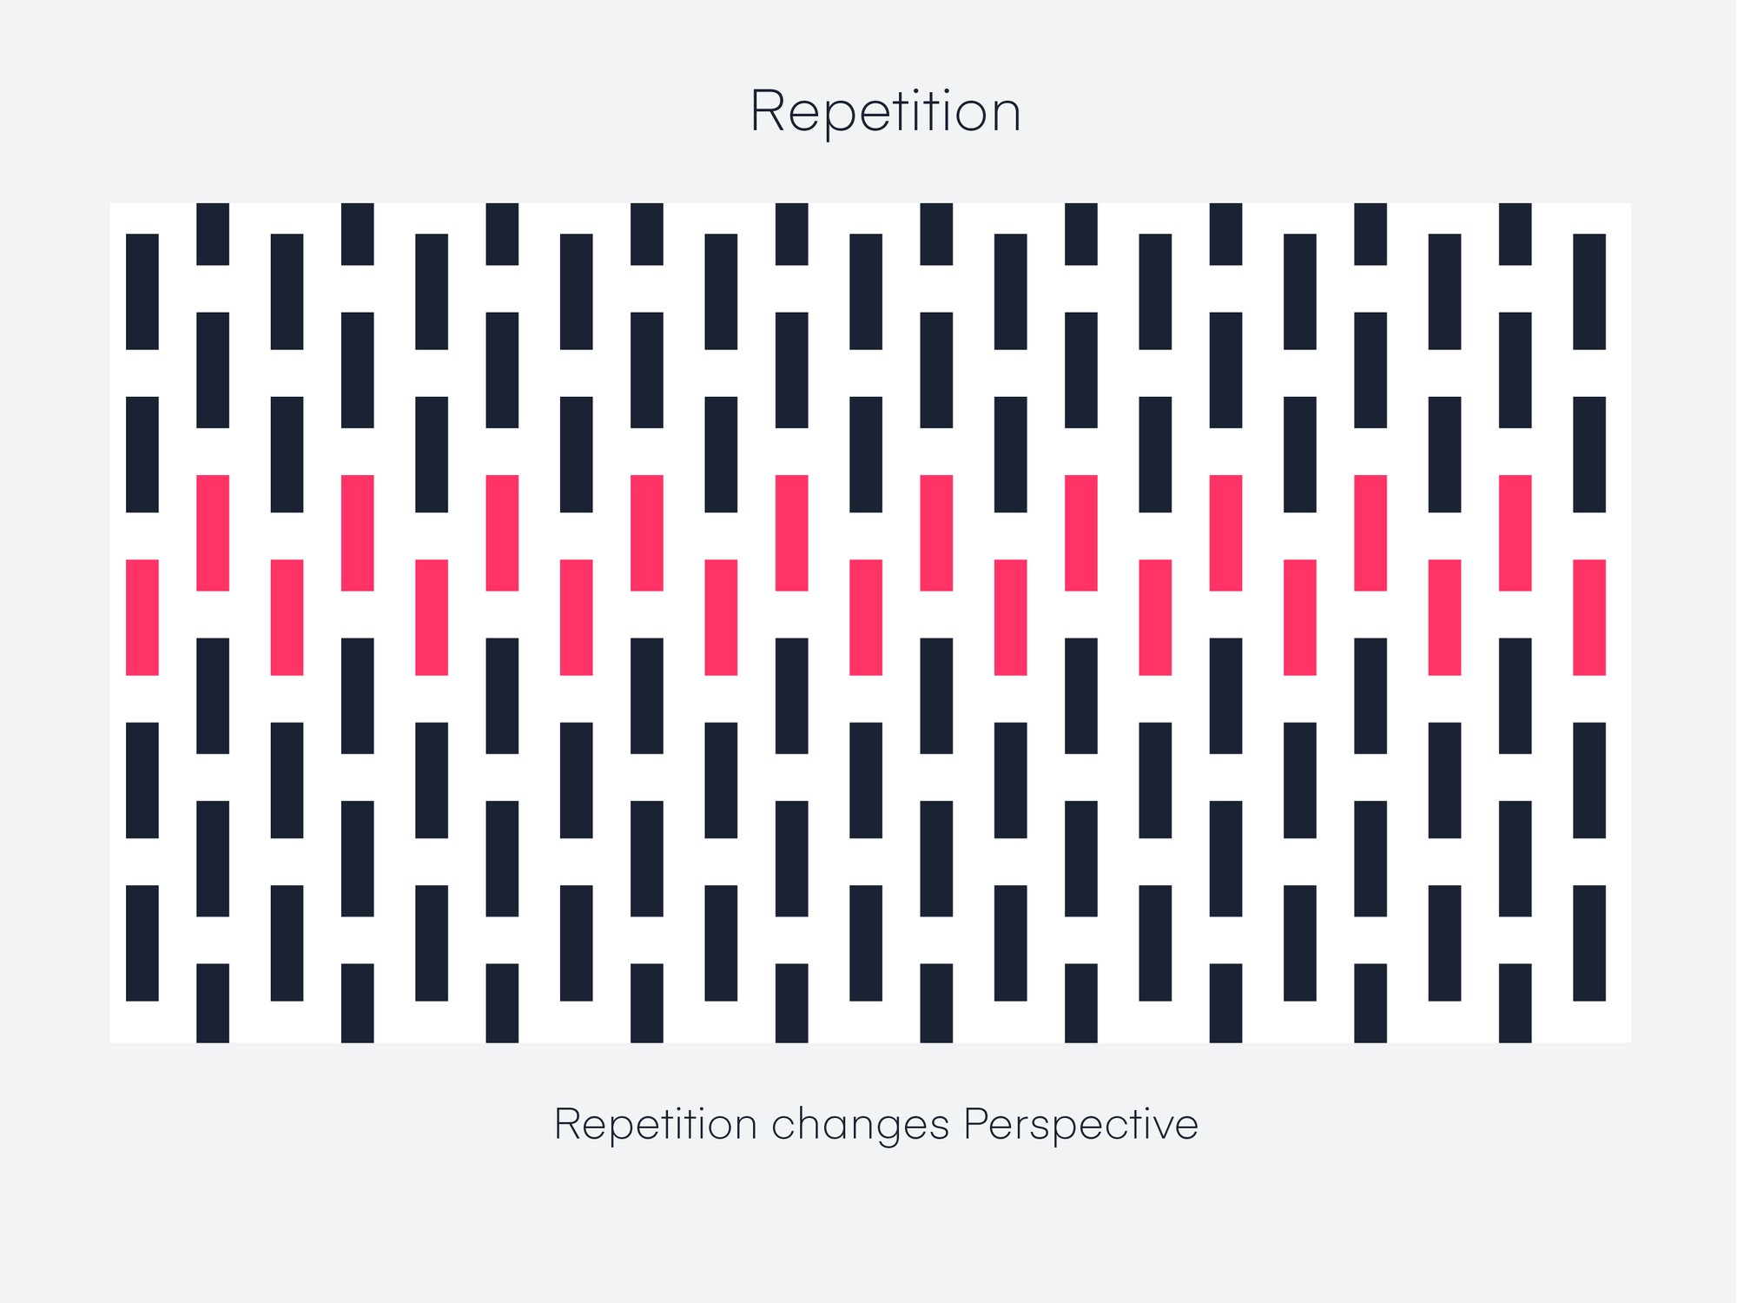
Principles of Design
Repetition
Repetition is the recurrence of a design element, commonly utilized in patterns or textures. Repetitive elements can be used in conjunction with other principles to create a design that leads a user’s eye to a focal point, has continuity, or flow. A repetitive element could be repeated lines, shapes, forms, color, or even design elements.

Slide 31
Introduction to Design Thinking
Design thinking is a non-linear, iterative process that teams use to understand users, challenge assumptions, redefine problems and create innovative solutions to prototype and test.
Why Is Design Thinking so Important?
In user experience (UX) design, it’s crucial to develop and refine skills to understand and address rapid changes in users’ environments and behaviors.
professionals from a variety of fields, including architecture and engineering, subsequently advanced this highly creative process to address human needs in the modern age.
Twenty-first-century organizations from a wide range of industries find design thinking a valuable means to problem-solve for the users of their products and services.

Slide 32
Why Is Design Thinking so Important?
Design teams use design thinking to tackle ill-defined/unknown problems (aka wicked problems) because they can reframe these in human-centric ways and focus on what’s most important for users. Of all design processes, design thinking is almost certainly the best for “thinking outside the box”.
With it, teams can do better UX research, prototyping and usability testing to uncover new ways to meet users’ needs.
With design thinking, teams have the freedom to generate ground-breaking solutions. Using it, your team can get behind hard-to-access insights and apply a collection of hands-on methods to help find innovative answers.

Slide 33
Introduction to design thinking
Design thinking is a non-linear, iterative process that teams use to understand users, challenge assumptions, redefine problems and create innovative solutions to prototype and test.
Involving five phases
Empathize,
Define,
Ideate,
Prototype and
Test

Slide 34
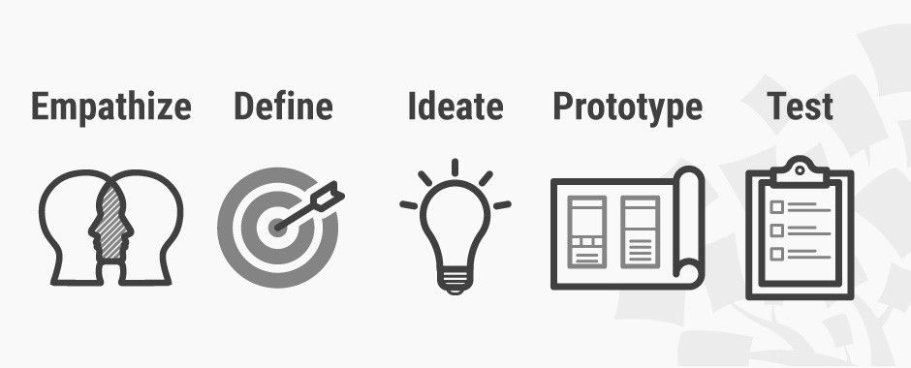
Introduction to design thinking
The Five Stages of Design Thinking
Stage 1: Empathize—Research Your Users' Needs.
Stage 2: Define—State Your Users' Needs and Problems.
Stage 3: Ideate—Challenge Assumptions and Create Ideas.
Stage 4: Prototype—Start to Create Solutions.
Stage 5: Test—Try Your Solutions Out.

Slide 35
The Five Stages of Design Thinking
Stage 1: Empathize—Research Your Users' Needs.
Here, you should gain an empathetic understanding of the problem you’re trying to solve, typically through user research.
Empathy is crucial to a human-centered design process such as design thinking because it allows you to set aside your own assumptions about the world and gain real insight into users and their needs.
Stage 2: Define—State Your Users' Needs and Problems
It’s time to accumulate the information gathered during the Empathize stage.
You then analyze your observations and synthesize them to define the core problems you and your team have identified. These definitions are called problem statements.
You can create personas to help keep your efforts human-centered before proceeding to ideation.

Slide 36
The Five Stages of Design Thinking
Stage 3: Ideate—Challenge Assumptions and Create Ideas
Now, you’re ready to generate ideas.
The solid background of knowledge from the first two phases means you can start to “think outside the box”, look for alternative ways to view the problem and identify innovative solutions to the problem statement you’ve created.
Brainstorming is particularly useful here..
Stage 4: Prototype—Start to Create Solutions
This is an experimental phase. The aim is to identify the best possible solution for each problem found.
Your team should produce some inexpensive, scaled-down versions of the product (or specific features found within the product) to investigate the ideas you’ve generated. This could involve simply paper prototyping.
Stage 5: Test—Try Your Solutions Out
Evaluators rigorously test the prototypes. Although this is the final phase, design thinking is iterative: Teams often use the results to redefine one or more further problems.
So, you can return to previous stages to make further iterations, alterations and refinements – to find or rule out alternative solutions

Slide 37
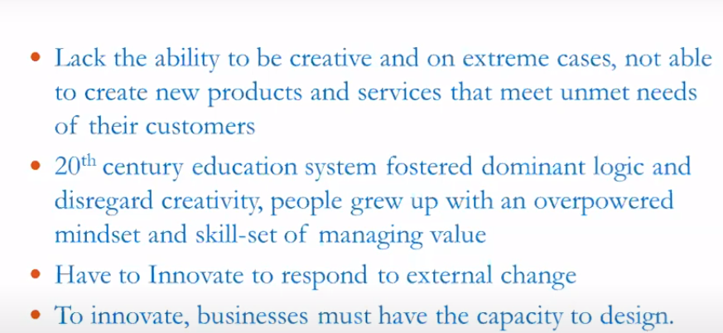
Origin of Design Thinking

Slide 38
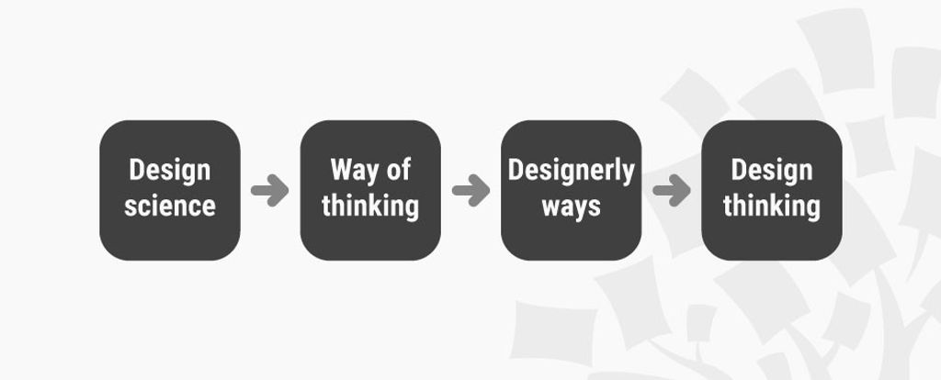
History Of Design Thinking
Design Thinking emerged from an exploration of theory and practice, in a range of disciplines and sciences, as a means of addressing the human, the technological and strategic innovation needs of our time.
Design Thinking date back to the 50's and 60's, and struggled to grapple with the rapidly changing environment in those times.
New approaches to solving complex problems had their roots in the thinking applied to World War II, an event that had a profound effect on strategic thinking in the modern world and fundamentally changed the way we apply ourselves to management, production and industrial design.

Slide 39
History Of Design Thinking
The History of Design Thinking traces its origins back to the mid-20th century when academics and practitioners began to examine the creative strategies employed by designers. Rooted in architecture and industrial design, these strategies evolved into a systematic approach known as Design Thinking. This method prioritises empathy, collaboration, and experimentation in problem-solving.
Over the decades, it has transcended its original fields, influencing the business, technology, and education sectors. This evolution underscores the adaptability and relevance of Design Thinking. Read this blog to learn about the History of Design Thinking, its timeline, process, reasons for its popularity, and its future.

Slide 40
The roots of Design Thinking
The early insights of Design Thinking date back to the early 50s and 60s when people started studying Design Reasoning and Design Methodology. However, these are often associated with the context of ancient architecture and engineering, which were limited to implementing complex scientific ideas into practical life.
Design Thinking is much more than just a process; it is a mindset that encourages the relentless pursuit of understanding, creativity, and innovation. By placing human needs at the heart of the problem-solving journey, Design Thinking empowers individuals and teams to generate transformative solutions that have a lasting impact on society.
Even though it is nearly impossible to figure out all the aspects that led to the birth of Design Theory and how it functions, it is widely believed that strategic thinking took a giant leap after the Second World War.

Slide 41
Timeline of Design Thinking
1960s
In the 1960s, designers applied scientific methodology to understand design functions and influences. Nigel Cross's paper explores the struggle between design discipline and design science, aiming to make design scientific and rational.
In the early days, it was known as participatory methodology. Before the label was given to this method by subsequent innovations in design, it was primarily used in urban planning and designing.
1970s
Herbert A. Simon, a Nobel Prize laureate, introduced design as a 'way of thinking' in his book, The Sciences of the Artificial. He introduced Design Thinking principles, including rapid prototyping and observation, which are core to modern design and entrepreneurial processes.
As participatory methodology developed throughout the 70s, it grew to be considered an interdisciplinary interaction design language. Science has inspired many methods in participatory design, such as usability testing across the departments, including role-playing, prototyping and mock-ups.

Slide 42
Timeline of Design Thinking
1980s
In 1982, Nigel Cross's "Designerly Ways of Knowing" paper compared designers' problem-solving processes to non-design-related solutions in everyday life. Brian Lawson, Emeritus Professor at the University of Sheffield, discussed insights from tests comparing methods scientists and architects use to solve ambiguous problems.
1990s
IDEO, a global design and innovation company, introduced Design Thinking to the mainstream, creating customer-friendly terminology and toolkits. Richard Buchanan, Head of Design at Carnegie Mellon University, discusses its origins and how sciences evolved into specializations. Design Thinking integrates specialised fields of knowledge to address global problems from a holistic perspective.

Slide 43
Timeline of Design Thinking
2000s
David Kelley founded Stanford's Hasso Plattner Institute of Design, which focuses on Design Thinking development and implementation. The Design Thinking movement was rapidly gaining ground, with pioneers like IDEO and the design schools paving the way for others. Universities, business schools, and companies have adopted the methodology, sometimes re-interpreting it to suit their context or brand values.
Present day
The Industrial Revolution and World War II both stretched our understanding of what was technologically feasible. Due to the immense social changes at the time, engineers, architects, industrial designers, and cognitive scientists started to focus their research on problem-solving.
From the 50s and 60s onward, Design Thinking emerged, or perhaps, converted the technique by infusing the period's strategic, technological, and human needs. It evolved gradually over five decades only to become the prominent innovation methodology of modern times.
It keeps on exploding and enriching by those at the front end contributing to the research and development. Design Thinking is still being improved by people at the forefront of research and development and is gaining ground across many industries.

Slide 44
Future of Design Thinking
Design Thinking is a part of creative thinking and problem-solving. Many people believe that Design Thinking is only for designers. However, that is not true. Anyone who wants to be more creative and innovative can use Design Thinking as a tool.
Modern science and rapid technological changes can turn around the future of Design Thinking. It will continue to evolve and be used across different domains to create new products and services with an enriched user experience.
All facets of the economies and industries across domains have embraced Design Thinking. But software development, where the destination may be unclear at first and tweaks are frequently needed, is where it finds its most significant application. This unconventional method of producing creative products works more effectively when addressing vague and unidentified difficulties. These stages are a journey towards an objective rather than being inherently hierarchical or linear. Despite being relatively new to the business, designers have always used this approach naturally.
Integrating Artificial Intelligence and Machine Learning can unlock new avenues for Design Thinkers. The future of Design Thinking lies in its capacity to help people solve even more complex problems in the best creative way possible. As problems in the world become more complex, there will be a need for people who can think outside the box.

Slide 45
New materials (Tools in Industry)
It is a Design Thinking tool that involves empathy and is a part of what the company calls its immersion initiative. Each fiscal quarter, design people from the UberEATS team visit one of their operating cities to deep dive into its food culture. After studying the logistical difficulties, transportation issues, speaking with delivery partners, restaurants, and consumers, they eat. Design Thinking: From Insights to Viability course
What is Design Thinking?
Design thinking in layman’s language is the best new way of organizing work. Some call it a social technology that has revolutionized how business management systems work.
It involves solving problems by building products that cater to the customer’s needs. The process keeps the end-user in the front-back-center at every stage of creation, right from the time the idea happens to the product delivery.
Design thinking is not industry-specific and can be applied to any problem and help streamline a business process with simplicity.

Slide 46
New materials (Tools in Industry)
Since Design Thinking owes its popularity to being customer-centric, the tools used in the process (from creating to delivering products/ services) are also life-sensitive.
Let’s take a look at some of these tools to understand them better.
1. Immersion
This is perhaps the first tool that is utilized in any process of design thinking. Just when you begin to think about a problem that needs to be solved or an idea for a product that will change life as we know it-immersion begins to happen.
Immersion includes various sub-processes:
Simulation: A day in the life of a person to understand her/his needs.
Research: After simulation, exploratory research related to the context surrounding the problem begins. Again, it can be multifaceted depending on the data that is to be collected and used.
Brainstorming: This tool is most crucial when it comes to collaborative brainstorming sessions with a team, stakeholders, or prospective innovators/product managers.
Overshadowing: After the three phases of ideation, overshadowing commences. This tool is used to monitor a client’s interaction with a product over a considerable period to understand preferences and dislikes.
Design Thinking Tools available in the market that can be used for undertaking Immersion are SessionLab, Stormboard, IdeaFlip, Smaply, Userforge, MakeMyPersona.

Slide 47
New materials (Tools in Industry)
2. Visualization
While the debate around what came first (idea/chair or chicken/egg) is unresolved and shall always be likely so, it has come to be generally accepted that visual thinking is an undeniable aspect of design thinking. Not just design thinking, all processes that involve human invention from industrial manufacturing to scientific discovery, everything begins in mind.
In Design Thinking, the visualization tool is crucial. After identifying the problem or lack in Step 1(Immersion), the second step is to visualize how to solve the problem.
In this regard, visual thinking helps designers to imagine/create a niche product that is suitable to the needs of the market it wishes to bring about a change in.
For example, to manufacture a chair, one has to think of a platform that is raised above the ground and can be used to sit upon. This is visualization.
However, visualization cannot be open-ended, meaning unless a designer draws the chair she wants to sell in the market, the entire team will have its perception of what a chair should look like.
This is a problem that many organizations encounter. Although we are all for ‘an idea can come from anywhere, we do not want to be in a situation where the decision to go with any single idea of a chair becomes a hassle.
Tools available in the market for Visualization: Miro, Conceptboard, Google Jamboard, Mural, Shape.

Slide 48
New materials (Tools in Industry)
3. Mind Mapping
Mind Mapping, one of the key tools for designers, helps generate, structure, interlink, and classify ideas to look for patterns around how the final design will come about.
An intermediate phase overlaps through all design thinking processes; the tool relates products to one central idea/product.
Mind Mapping can happen only in a team setup. The customer base can participate by being asked to draw relatable patterns from the data we as an organization present to them.
Then proceed to ask questions like, “Based on what we have learned from data patterns, what features would our design have,” to your team.
Segregation of patterns based on depth to let newer meanings emerge from the information can allow the possibility of developing a product with zero loopholes or an assembly line of products if it is a niche market.
For instance; What is the first thing that comes to mind when someone says, Tesla?
Naturally, after Elon Musk, it is their Electric Vehicles (also known as EV’s).
The reason why we mention Tesla’s Electric Car is that the electric automobile is not an innovation. It has been around for some 200 years. But Tesla’s use of a design thinking tool- mind mapping- helped them identify the challenges around electric cars to now have the most successful and profitable EV fleet in the world.
Design Thinking Tools in the market that can be used for Mind Mapping: ClickUp, Ayoa, Miro, SmartDraw, MindMeister, Milanote, Microsoft Visio, MindGenius, Lucidchart.

Slide 49
New materials (Tools in Industry)
4. Rapid Iteration
As discussed earlier, in the UberEATS program case, the designers from the company also apply the Rapid Iteration tool to test designs quickly in the real world.
But what is so rapid about it?
In the fast-paced world we live in today, where competition is tighter than ever, it is necessary to adapt quickly to sustain your organization.
For instance, in the case of E-commerce platforms or food delivery organizations like Swiggy, all stakes are dependent on the sharp sword of time.
In such scenarios, where coordination between people and objects from the real world cannot be replicated in office spaces, a quick iteration design thinking tool works best.
Therefore, testing designs quickly in the real world, improving upon them, and re-testing keeps the market open for innovation.
If you have spent too much time solving small logistical problems, the entire chain of operations can be affected.

Slide 50
New materials (Tools in Industry)
5. Assumption Testing
Assumption Testing is not only part of the curriculum in Management courses but also is an important design thinking tool.
In 2009, two Harvard Business School graduates launched Rent the Runway on the assumption that customers like to rent dresses over the internet.
The founders tested this assumption before proceeding and looked at where the company stands today.
Assumption testing implies identifying assumptions, stereotypes, and prejudices that underlie the attractiveness of any new product and then testing it. It involves thought testing and field experiments.
This design thinking tool uses large amounts of data to classify a) what might work,b) what generally works, c) what should not work and why it works.
If one were to give an example to elaborate further, we would take the case of Fair & Lovely, which is now Glow & Lovely.
Can you think of the kind of assumption testing the beauty brand did to take a step towards a more inclusive brand image that the company now wishes to establish?

Slide 51
New materials (Tools in Industry)
6. Prototyping
This is the tool that turns your idea into material reality. The idea of the chair (we have discussed above) becomes a full-fledged prototype of a chair. This prototype can then be sent across to your stakeholders and partners for feedback.
Prototyping is about minimizing the I of ROI (Return on Investment) to the extent that the cost of your first 2 D prototype is that of a pencil or a piece of bread. Most businesses these days proceed with 2 D prototypes before going on with 3D models. Therefore, prototypes can also include storyboards, images, role-play, skits, etc.
As a design thinking tool, Prototyping can become quite painful for designers, who have clocked in sweat and tears to make their prototype. However, one should let others validate the product rather than explain its features or defend it from criticism.
Tools available in the market for Prototyping are Boords, Mockingbird, POP-app by Marvel, PowerPoint, Keynote, Lumen5, or Moovly, Proto.io.

Slide 52
New materials (Tools in Industry)
7. Finding the Value Proposition
Rather than adding more features to your product, focus on finding value. However minimal that may be, the value should be irreplaceable.
For instance, take Apple. When Steve Jobs left the organization in 1985, Apple changed its product development cycle completely. It launched more and more products, pumped millions into R & D around them, but hardly found success.
When Jobs returned to the company in 1997, he dumped the old product cycle and established a new line of products using design thinking. Yes, he specifically used this ‘value proposition’ tool to launch and fund R & D around very few products that no one but Apple could deliver with the best software and hardware service in the world.
This was a long shot and a big risk but see where it got Apple. In no time, the company became a market leader in smartphones and computers.
According to CompaniesMarketCap, Apple is the world’s most valuable company today, with a total worth of $2.430 trillion.
There are no specific tools in the market for creating a roadmap of the value proposition for your stakeholders or clients but suffice it to say that some basic ones like Strategyzer’s Value Proposition Canvas, emaze, Canva, and PiktoChart will do the job.

Slide 53
New materials (Tools in Industry)
8. Learning Launch
Once your prototype is approved, it goes to the final end-user, your customer. Learning Launch is the tool wherein your test product is launched in the market for a quick experiment.
In contrast to a new product launch, this test is conducted solely for gathering data.
As a design thinking tool, Learning Launch can be difficult to navigate through. After all, liking your product does not mean one will buy it.
Money is dear to all, and the real challenge lies in convincing the customer to part with it willingly to buy your product. While one may say that’s the job of advertising and marketing, the first step towards initiating the process of willful buying happens through this stage.
The most critical aspect of this tool is that unlike traditional analysis and case studies that happen over a long period, this approach works for short periods.
The Learning- launch process is based on the Darden Growth Leader Research Project about which you can read here.
Since there is no perfect algorithm to achieve the perfect product, design thinking uses this tool to learn along the way.
For example, post-lockdown, the French government’s initiative to make the country green, sustainable and inclusive translated into making 650-km bicycle lanes throughout the territory. It was an urban planning project that worked along the learning launch process to see what works best.
While there are no specific tools in the market, there are detailed case studies and analytical recommendations that explain this process. The most prominent Darden Research has already been mentioned earlier.

Slide 54
New materials (Tools in Industry)
9. Collaborative Creation
Ask any product manager: What is the hardest thing about creating a product? Most likely, they will say it is the time when the MVP (Minimum Viable Product) is out in the market for testing.
A crucial component of this testing phase is also data analysis. Besides having the product used by multiple customers and stakeholders, a team is also enrolled in the data collection process around the product’s feedback.
Traditionally, Six Sigma has taught manufacturers to launch their prototypes with all features intact. The producers launch next-to-finish products for testing in the market, get a so-so response and then sulk.
But, with design thinking, the approach to innovation changes.
So what if your MVP is roughly cut and not etched out with perfection? In the fast lives we lead, the quicker a product is rolled out for testing, the better and immediate the response from the customer. Thus, making value-added differentiation possible in a market of infinite products and services.
A tip that always works in this stage is to present the customer with an incomplete product. This makes intuition work and is a good way to engage a buyer’s creativity and intellect. Offering multiple prototypes can make this process even better for zeroing in on your final product.
Tools available in the market for helping co-create: Any data collection tool like Excel, Tableau, Xplenty, and Digsite. One can even use UserTesting for real-time feedback.

Slide 55
New materials (Tools in Industry)
You know they say that the oldest profession in the world is the art of storytelling. Since storytelling has been used in every craft and art practice, including business, this has become a primary production tool. As part of design thinking, this tool, if not used properly, can result in returning to phase 1, Immersion.
After all, without convincing the customer, how do you expect your product to sell? It is where the art of selling and the whole body of professional advertisers and marketers come to play.
The art of selling revolves around creating presentations and storyboards around your product. Narratives that reveal a problem, how we tackle it daily, and how your solution is best in the market because using metaphors, analogies, and data to drive home your product and service is key to nailing the art of selling.
If you see any successful life-cycle of a product or service, notice that how it was introduced in the market made all the difference in bringing about sales and staying in the minds of consumers forever.
Think of the most popular and evergreen slogan from the world of advertising that you have heard.

Slide 56
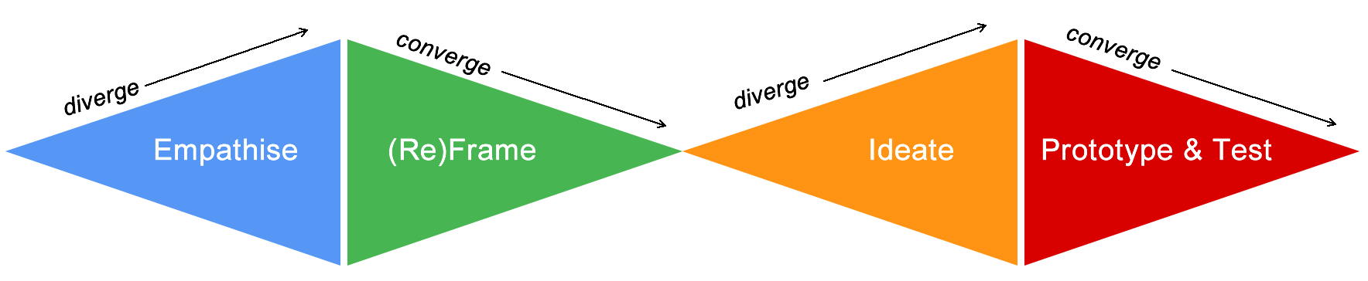
Design Thinking Process
P r o b l e m S p a c e
S o l u t i o n S p a c e
Design
Challenge
Design
Solution

Slide 57
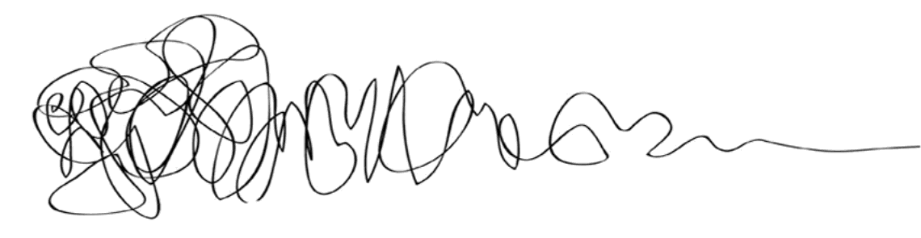
Design Thinking
P r o b l e m S p a c e
S o l u t i o n S p a c e
Design
Challenge
Design
Solution

Slide 58
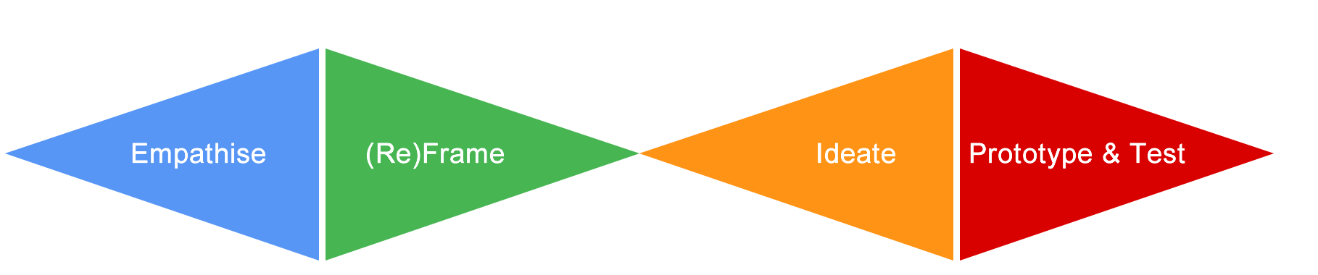
Design Thinking Branding
Design Thinkers Group
Empathize | (Re)frame | Ideate | Prototype | Test
Stanford d.school
Ideo
Ideo v2.0
Luma Institute
IBM
FSU Innovation Hub
Empathize | Define | Ideate | Prototype | Test
Gather | Generate | Make | Share
Inspiration | Ideation | Implementation
Looking | Understanding | Making
Observe | Reflect | Make
Empathize | Ideate | Build

Slide 59
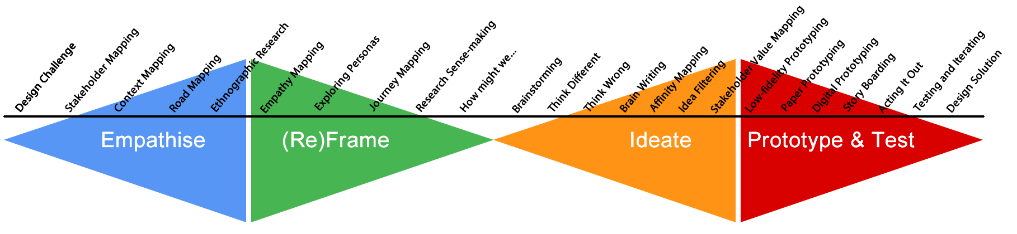
Design Thinking Methods & Tools
Design Thinkers Group
Stanford d.school
Ideo
Ideo v2.0
Luma Institute
IBM
FSU Innovation Hub
Empathize | (Re)frame | Ideate | Prototype | Test
Empathize | Define | Ideate | Prototype | Test
Gather | Generate | Make | Share
Inspiration | Ideation | Implementation
Looking | Understanding | Making
Observe | Reflect | Make
Empathize | Ideate | Build

Slide 60
Design Thinking Steps in Perspective

Slide 61
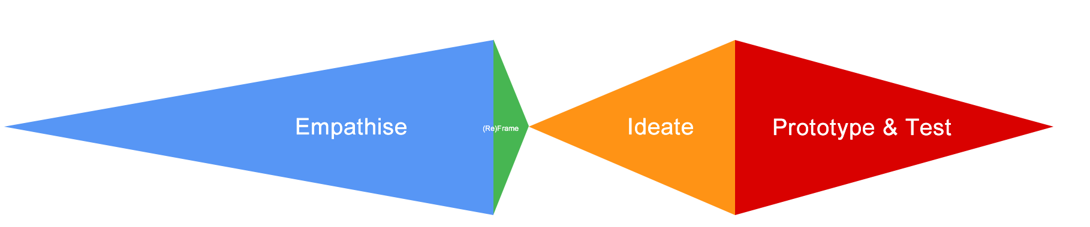
Design Thinking Steps in Perspective

Slide 62
Class Activity 1: Problem Statement
How might we improve the grocery shopping experience in a manner that positively impacts people and the environment?

Slide 63
END of UNIT I

